Slide 1
Tic-Tac-Toe
Using the Graphing Calculator for Derivatives

Slide 2
Rules
Each Pair has a Tic-Tac-Toe Board
One problem will be displayed. Each person will do the problem.
First player to get correct answer on his/her calculator gets to mark the board.
Goal: To win as many TIC-TAC-TOES as possible

Slide 3
Problem 1
Find f ’(4)
f (x) = 3x² + 4x - 2

Slide 4
Problem 1: Solution
f ’ (4) = 28

Slide 5
Problem 2
Find f ’(-1)
f (x) = sin πx

Slide 6
Problem 2: Solution
f ’ (-1) = -3.142

Slide 7
Problem 3
Find f ’(3)
f (x) = |x – 3|

Slide 8
Problem 3: Solution
f ’ (3) = DNE

Slide 9
Problem 4
Find dy at x = 4
dx
y = x² + 4x - 2

Slide 10
Problem 4: Solution
$${\frac{dy}{dx}}_{\left|x=4\right.}=12$$

Slide 11
Problem 5
Find dy at x = 1
dx
y = √ 3x – 2

Slide 12
Problem 5: Solution
$${\frac{dy}{dx}}_{\left|x=1\right.}=1.5$$

Slide 13
Problem 6
Find dy at x = 7
dx
y = √ x – 4

Slide 14
Problem 6: Solution
$${\frac{dy}{dx}}_{\left|x=7\right.}=0.289$$

Slide 15
Problem 7
Sketch the graph of the derivative of
f (x) = x³ + 4x² + 5

Slide 16
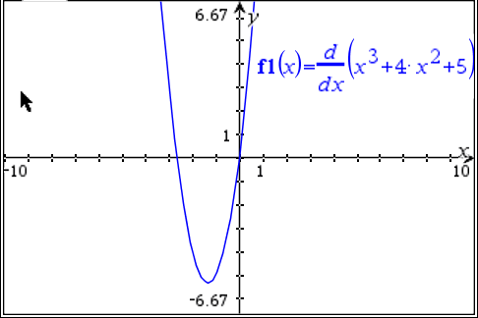
Problem 7: Solution

Slide 17
Problem 8
Find the equation of the tangent line for f (x) at x = 3
f (x) = 4x³ + x² – 1

Slide 18
Problem 8: Solution
$$y=114x−226$$

Slide 19
Problem 9
Find the equation of the tangent line for f (x) at x = -1
f (x) = x⁴ + x² – 1

Slide 20
Problem 9: Solution
$$y=−6x−5$$

Slide 21
Problem 10
Find the equation of the tangent line for f (x) at x = 0
f (x) = x² + 5x – 1

Slide 22
Problem 10: Solution
$$y=5x−1$$

Slide 23
Problem 11
Find the equation of the tangent line in point-slope form for f (x) at x = 5
f (x) = 4x³ + x² – 1

Slide 24
Problem 11: Solution
$$y−524=310(x−5)$$

Slide 25
Problem 12
Find the equation of the tangent line in point-slope form for f (x) at x = -3
f (x) = 2x³ + x² + x

Slide 26
Problem 12: Solution
$$y+48=49(x+3)$$

Slide 27
Problem 13
Find the equation of the tangent line in point-slope form for f (x) at x = 1
f (x) = 5x² – x – 1

Slide 28
Problem 13: Solution
$$y−3=9(x−1)$$

Slide 29
Problem 14
Find the equation of the tangent line in point-slope form for f (x) at x = -2
f (x) = 4x² + x

Slide 30
Problem 14: Solution
$$y−14=−15(x+2)$$

Slide 31
Problem 15
Find the equation of the tangent line in point-slope form for f (x) at x = π
f (x) = sin x + cos x

Slide 32
Problem 15: Solution
$$y+1=−1(x−π)$$

