Slide 1
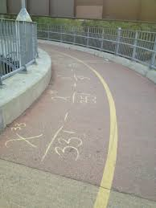



Name that Series

Slide 2

Name that Series Rules
All teams will be prepared with their answer on white board, desk, or paper.
Teams will take turns in giving their answer with different players sharing their team’s answer.
5 points earned for correct answer.
A team that incorrectly or does not name the series before the music ends will lose 5 pts. Honor system scoring

Slide 3

series

Slide 4

$$1+x+\frac{x^{2}}{2!}+\frac{x^{3}}{3!}+…+\frac{x^{n}}{n!}+…=\sum_{n=0}^{∞}{\frac{x^{n}}{n!}}$$

Slide 5
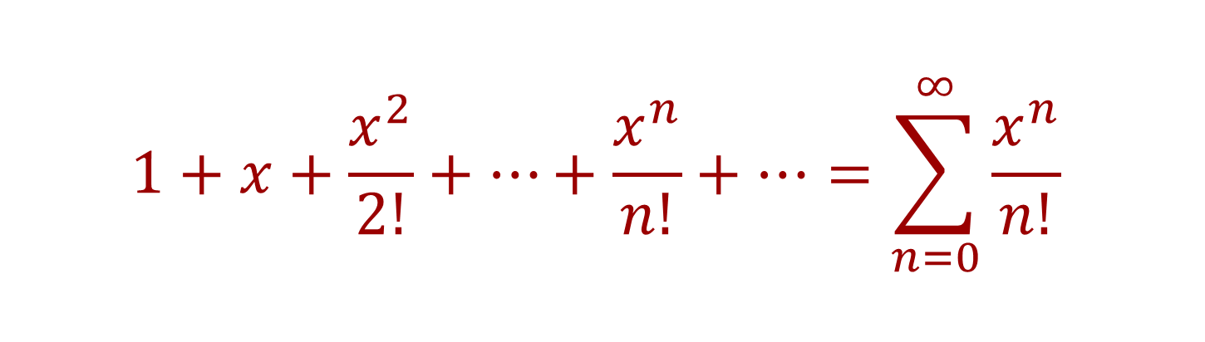
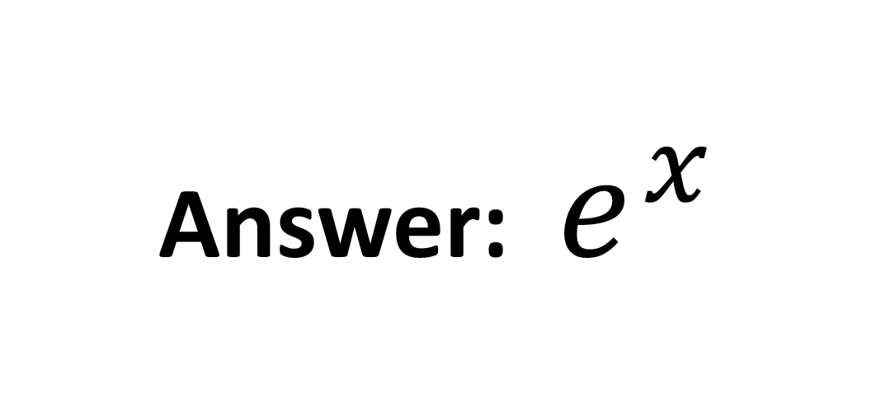
$$1+x+\frac{x^{2}}{2!}+…+\frac{x^{n}}{n!}+…=\sum_{n=0}^{∞}{\frac{x^{n}}{n!}}$$
Answer: $e^{x}$

Slide 6

$$1+x+x^{2}+…+x^{n}+…=\sum_{n=0}^{∞}{x^{n}}$$

Slide 7
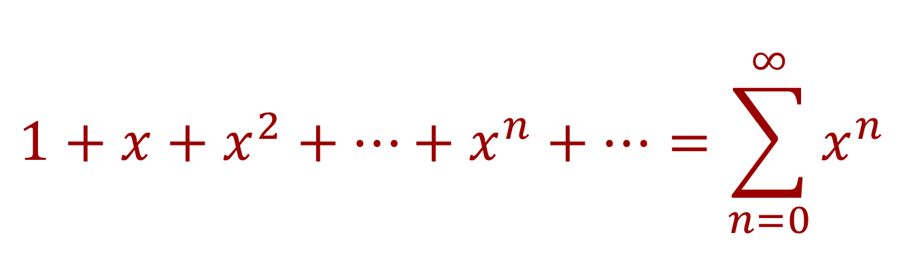
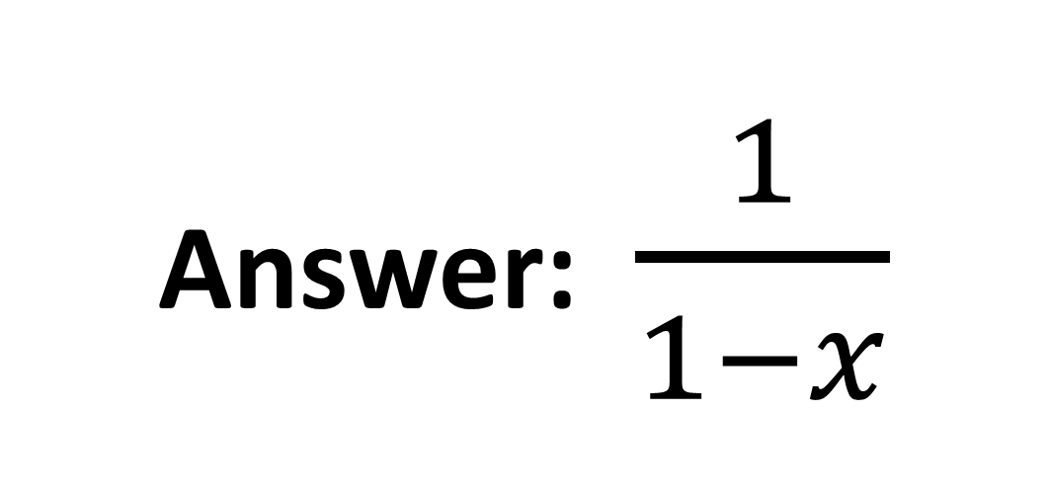
$$1+x+x^{2}+…+x^{n}+…=\sum_{n=0}^{∞}{x^{n}}$$
Answer: $\frac{1}{1−x}$

Slide 8

$$1−\frac{x^{2}}{2!}+\frac{x^{4}}{4!}−…+{(−1)}^{n}\frac{x^{2n}}{\left(2n\right)!}+…=\sum_{n=0}^{∞}{{(−1)}^{n}\frac{x^{2n}}{\left(2n\right)!}}$$

Slide 9
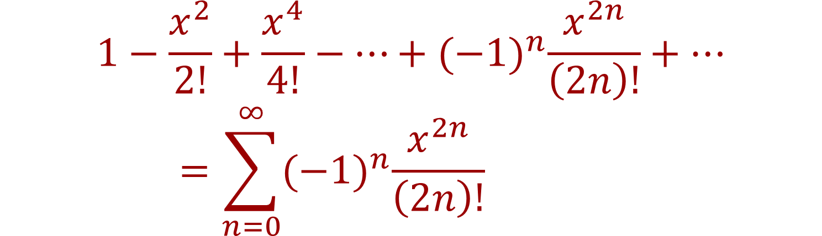

$$1−\frac{x^{2}}{2!}+\frac{x^{4}}{4!}−…+{(−1)}^{n}\frac{x^{2n}}{\left(2n\right)!}+…=\sum_{n=0}^{∞}{{(−1)}^{n}\frac{x^{2n}}{\left(2n\right)!}}$$
Answer: $cos x$

Slide 10

$$x−\frac{x^{2}}{2}+\frac{x^{3}}{3}−…+{(−1)}^{n−1}\frac{x^{n}}{n}+…=\sum_{n=1}^{∞}{{(−1)}^{n−1}\frac{x^{n}}{n}}$$

Slide 11
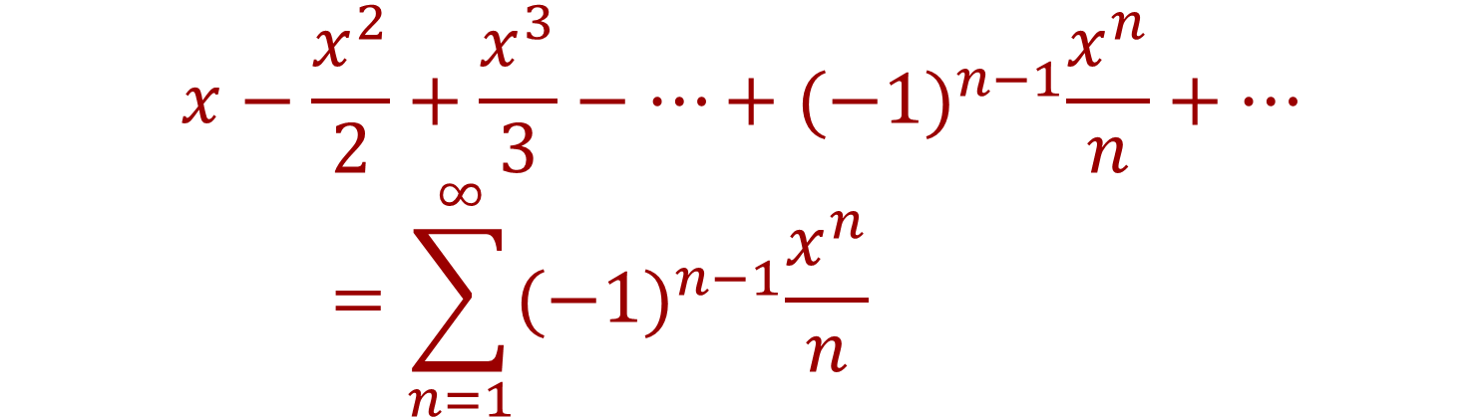
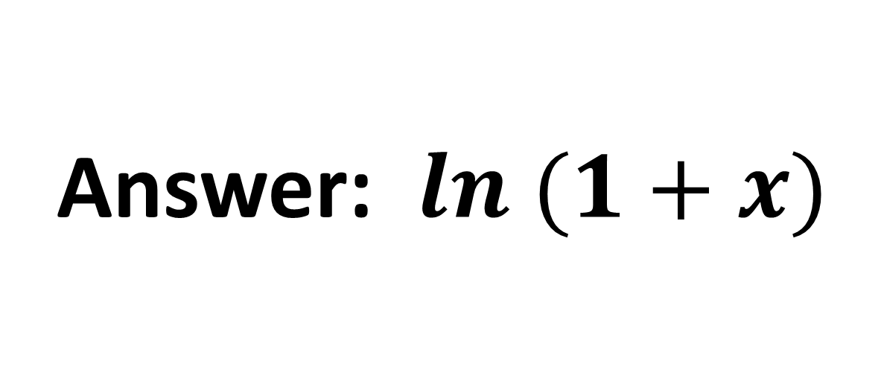
$$x−\frac{x^{2}}{2}+\frac{x^{3}}{3}−…+{(−1)}^{n−1}\frac{x^{n}}{n}+…=\sum_{n=1}^{∞}{{(−1)}^{n−1}\frac{x^{n}}{n}}$$
Answer: $ln (1+x)$

Slide 12

$$1−x+x^{2}−…+{(−x)}^{n}+…=\sum_{n=0}^{∞}{{{(−1)}^{n}x}^{n}}$$

Slide 13
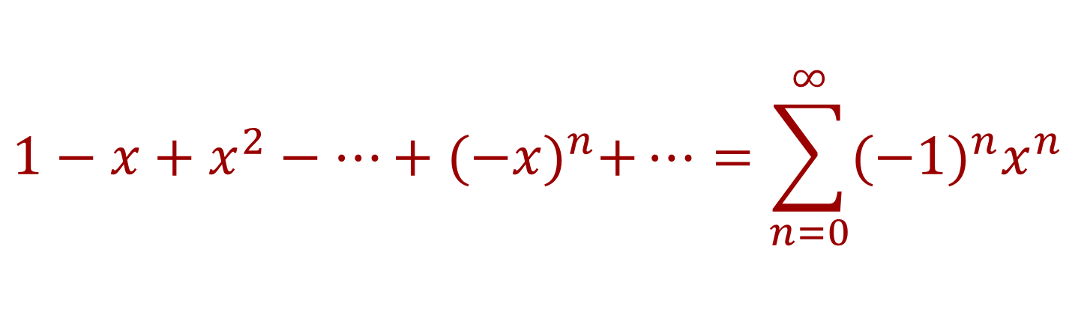
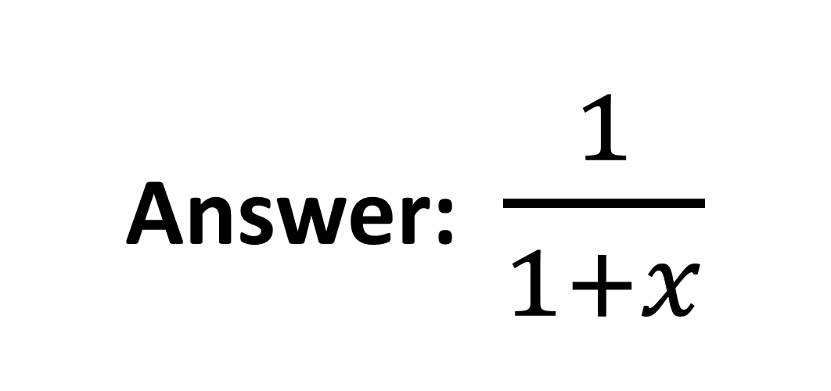
$$1−x+x^{2}−…+{(−x)}^{n}+…=\sum_{n=0}^{∞}{{{(−1)}^{n}x}^{n}}$$
Answer: $\frac{1}{1+x}$

Slide 14

$$x−\frac{x^{3}}{3!}+\frac{x^{5}}{5!}−…+{(−1)}^{n}\frac{x^{2n+1}}{\left(2n+1\right)!}+…=\sum_{n=0}^{∞}{{(−1)}^{n}\frac{x^{2n+1}}{\left(2n+1\right)!}}$$

Slide 15
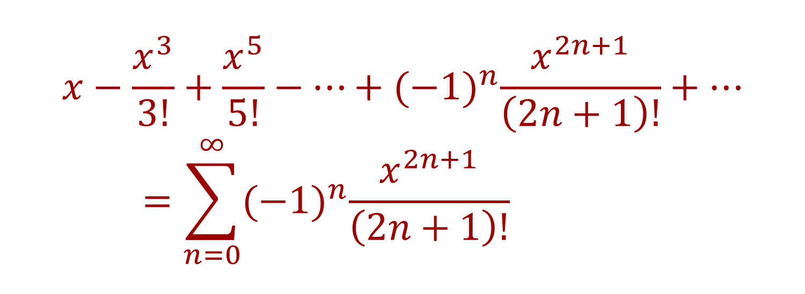
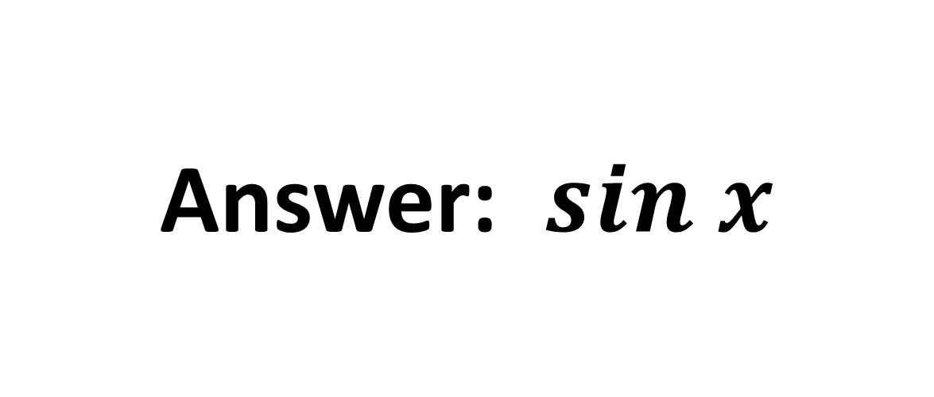
$$x−\frac{x^{3}}{3!}+\frac{x^{5}}{5!}−…+{(−1)}^{n}\frac{x^{2n+1}}{\left(2n+1\right)!}+…=\sum_{n=0}^{∞}{{(−1)}^{n}\frac{x^{2n+1}}{\left(2n+1\right)!}}$$
Answer: $sin x$

Slide 16

$$x−\frac{x^{3}}{3}+\frac{x^{5}}{5}−…+{(−1)}^{n}\frac{x^{2n+1}}{\left(2n+1\right)}+…=\sum_{n=0}^{∞}{{(−1)}^{n}\frac{x^{2n+1}}{\left(2n+1\right)}}$$

Slide 17
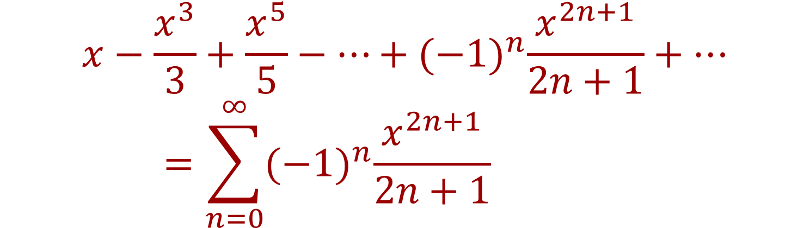
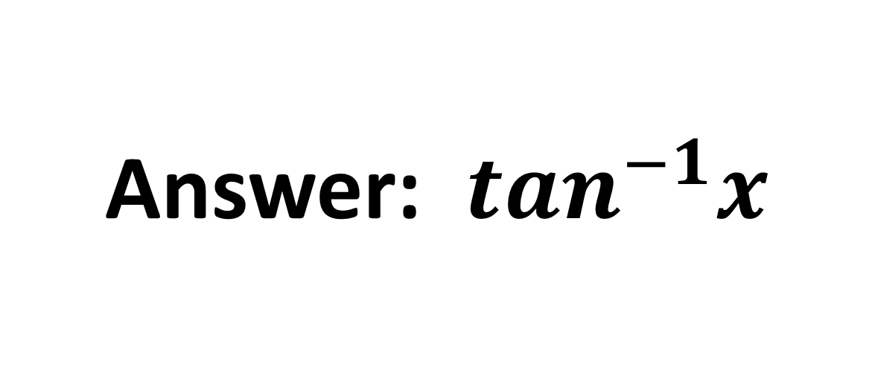
$$x−\frac{x^{3}}{3}+\frac{x^{5}}{5}−…+{(−1)}^{n}\frac{x^{2n+1}}{2n+1}+…=\sum_{n=0}^{∞}{{(−1)}^{n}\frac{x^{2n+1}}{2n+1}}$$
Answer: $\tan^{−1}x$

Slide 18

$$2x−\frac{{(2x)}^{3}}{3!}+\frac{{(2x)}^{5}}{5!}−…+{(−1)}^{n}\frac{(2{x)}^{2n+1}}{\left(2n+1\right)!}+…=\sum_{n=0}^{∞}{{(−1)}^{n}\frac{(2{x)}^{2n+1}}{\left(2n+1\right)!}}$$

Slide 19
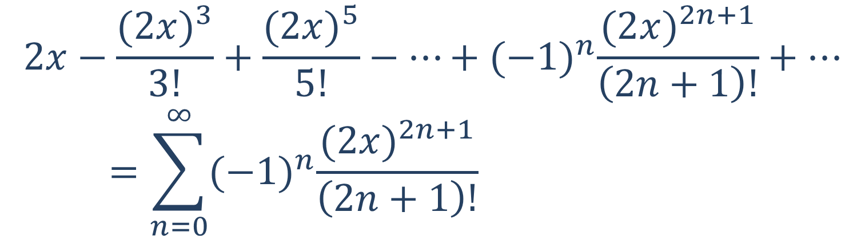

$$2x−\frac{{(2x)}^{3}}{3!}+\frac{{(2x)}^{5}}{5!}−…+{(−1)}^{n}\frac{(2{x)}^{2n+1}}{\left(2n+1\right)!}+…=\sum_{n=0}^{∞}{{(−1)}^{n}\frac{(2{x)}^{2n+1}}{\left(2n+1\right)!}}$$
Answer: $sin 2x$

Slide 20

$$1+\left(−x\right)+\frac{{\left(−x\right)}^{2}}{2!}+…+\frac{{\left(−x\right)}^{n}}{n!}+…=\sum_{n=0}^{∞}{\frac{{\left(−1\right)}^{n}x^{n}}{n!}}$$

Slide 21
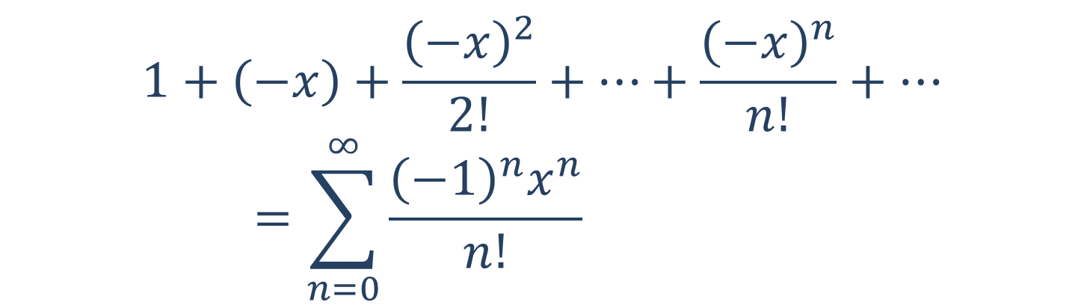
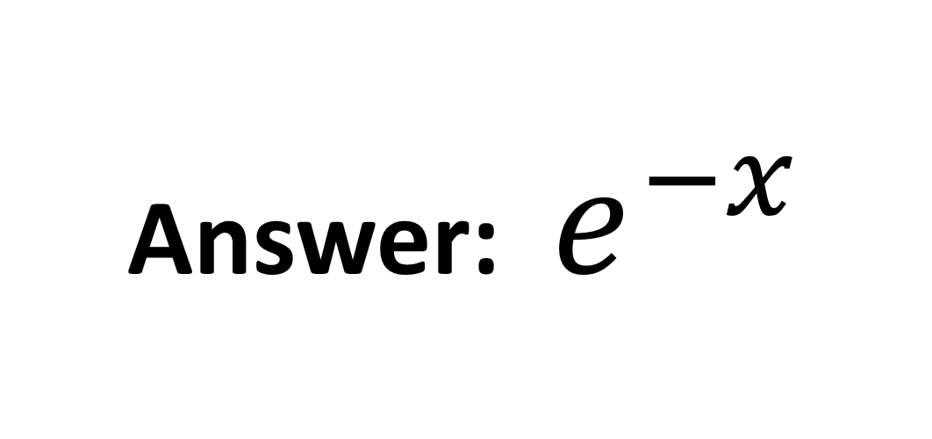
$$1+\left(−x\right)+\frac{{\left(−x\right)}^{2}}{2!}+…+\frac{{\left(−x\right)}^{n}}{n!}+…=\sum_{n=0}^{∞}{\frac{{\left(−1\right)}^{n}x^{n}}{n!}}$$
Answer: $e^{−x}$

Slide 22

$$1+\left(−2x\right)+{\left(−2x\right)}^{2}−…+{\left(−2x\right)}^{n}+…=\sum_{n=0}^{∞}{{{\left(−1\right)}^{n}\left(2x\right)}^{n}}$$

Slide 23
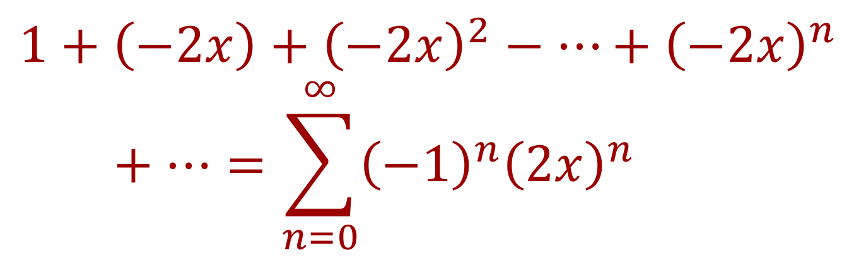
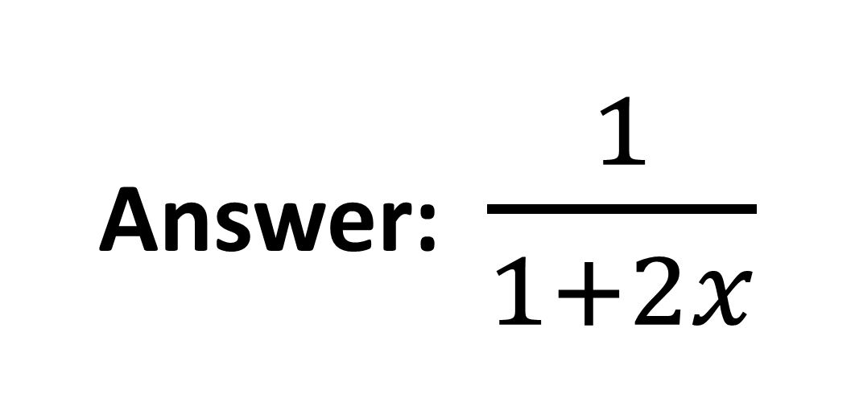
$$1+\left(−2x\right)+{\left(−2x\right)}^{2}−…+{\left(−2x\right)}^{n}+…=\sum_{n=0}^{∞}{{{\left(−1\right)}^{n}\left(2x\right)}^{n}}$$
Answer: $\frac{1}{1+2x}$

Slide 24

$$1+\left(x^{2}\right)+\frac{{\left(x^{2}\right)}^{2}}{2!}+…+\frac{{\left(x^{2}\right)}^{n}}{n!}+…=\sum_{n=0}^{∞}{\frac{x^{2n}}{n!}}$$

Slide 25
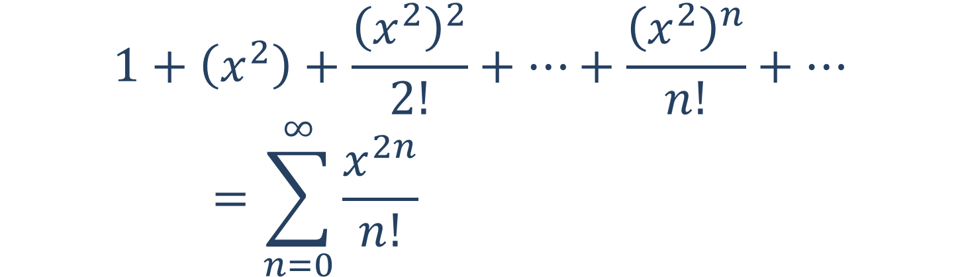
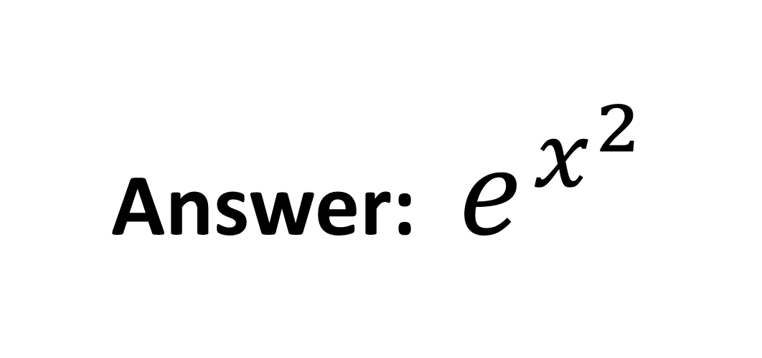
$$1+\left(x^{2}\right)+\frac{{\left(x^{2}\right)}^{2}}{2!}+…+\frac{{\left(x^{2}\right)}^{n}}{n!}+…=\sum_{n=0}^{∞}{\frac{x^{2n}}{n!}}$$
Answer: $e^{x^{2}}$

Slide 26

$$x+x^{2}+\frac{x^{3}}{2!}+…+\frac{x^{n+1}}{n!}+…=\sum_{n=0}^{∞}{\frac{x^{n+1}}{n!}}$$

Slide 27
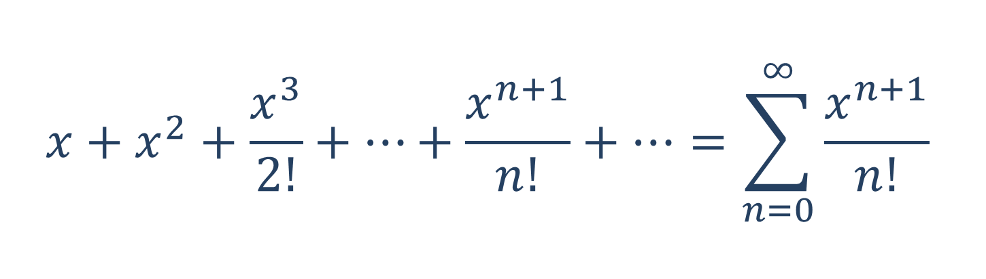

$$x+x^{2}+\frac{x^{3}}{2!}+…+\frac{x^{n+1}}{n!}+…=\sum_{n=0}^{∞}{\frac{x^{n+1}}{n!}}$$
Answer: ${xe}^{x}$

Slide 28

$$x^{2}−\frac{x^{4}}{2!}+\frac{x^{6}}{4!}−…+{(−1)}^{n}\frac{x^{2(n+1)}}{\left(2n\right)!}+…=\sum_{n=0}^{∞}{{(−1)}^{n}\frac{x^{2(n+1)}}{\left(2n\right)!}}$$

Slide 29
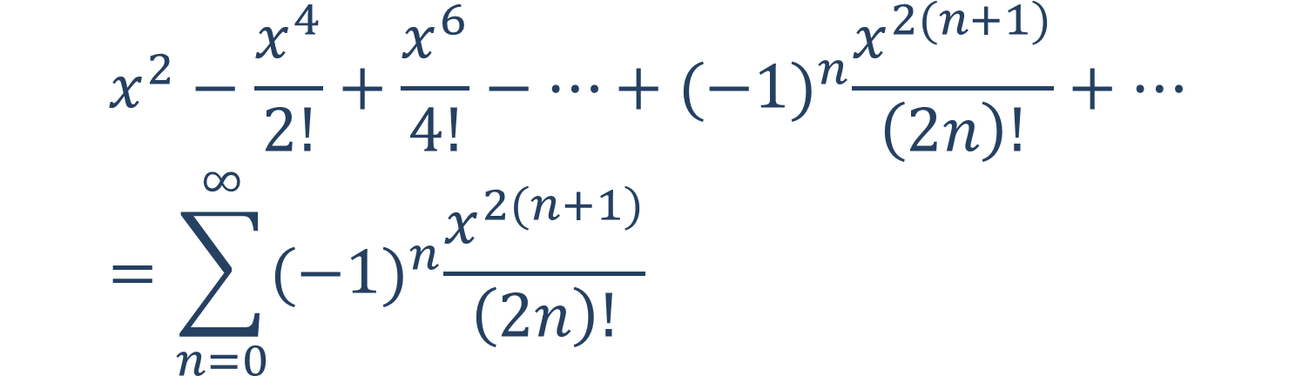
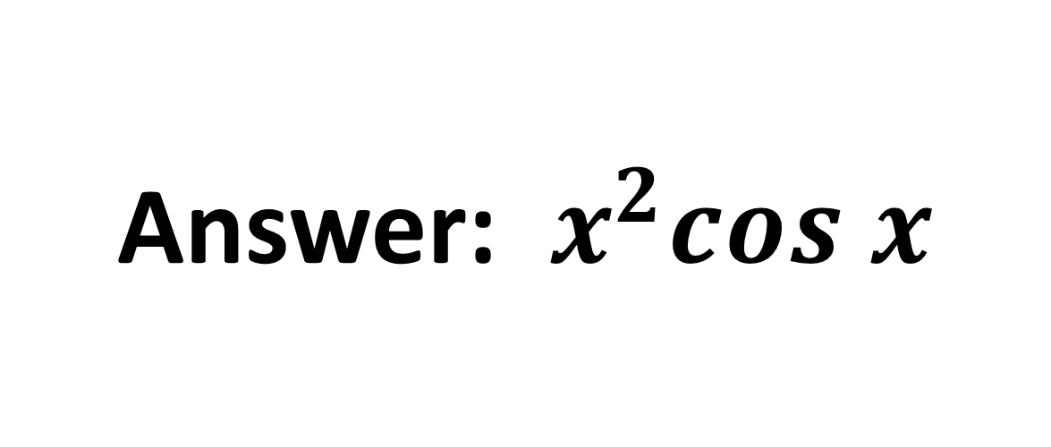
$$x^{2}−\frac{x^{4}}{2!}+\frac{x^{6}}{4!}−…+{(−1)}^{n}\frac{x^{2(n+1)}}{\left(2n\right)!}+…=\sum_{n=0}^{∞}{{(−1)}^{n}\frac{x^{2(n+1)}}{\left(2n\right)!}}$$
Answer: $x^{2}cos x$

Slide 30

$$x^{2}−\frac{x^{4}}{3}+\frac{x^{6}}{5}−…+{(−1)}^{n}\frac{x^{2n+2}}{2n+1}+…=\sum_{n=0}^{∞}{{(−1)}^{n}\frac{x^{2n+2}}{2n+1}}$$

Slide 31
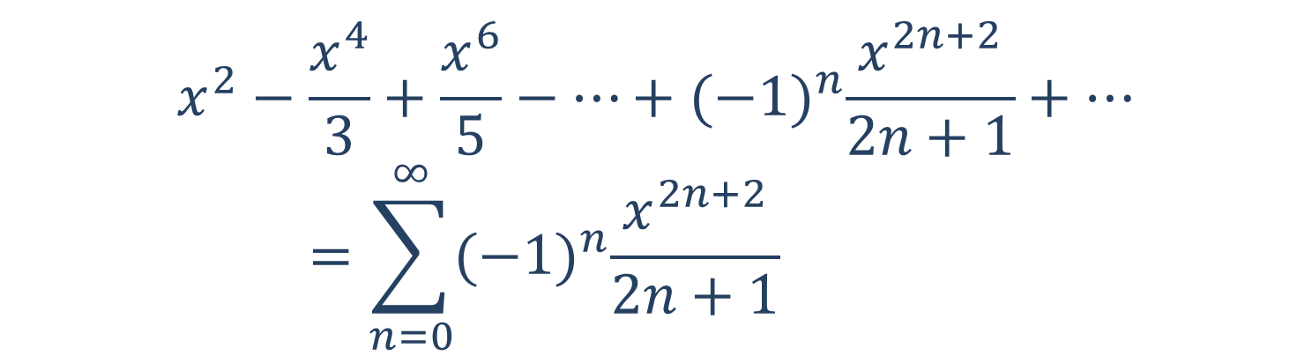
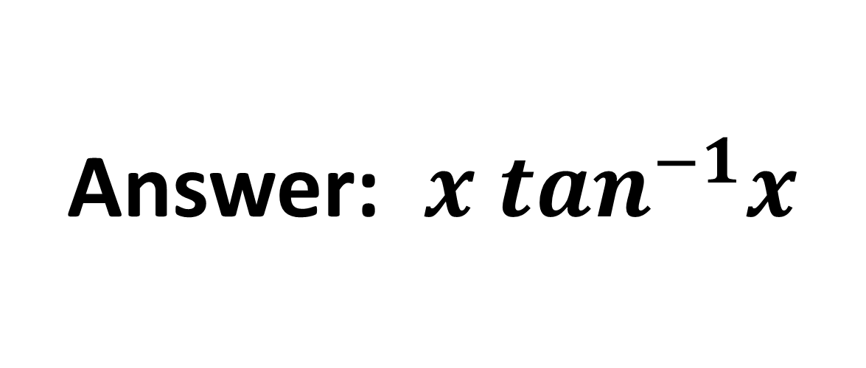
$$x^{2}−\frac{x^{4}}{3}+\frac{x^{6}}{5}−…+{(−1)}^{n}\frac{x^{2n+2}}{2n+1}+…=\sum_{n=0}^{∞}{{(−1)}^{n}\frac{x^{2n+2}}{2n+1}}$$
Answer: ${x tan}^{−1}x$

Slide 32

$$x+\frac{x^{2}}{2!}+…+\frac{x^{n}}{n!}+…=\sum_{n=1}^{∞}{\frac{x^{n}}{n!}}$$

Slide 33
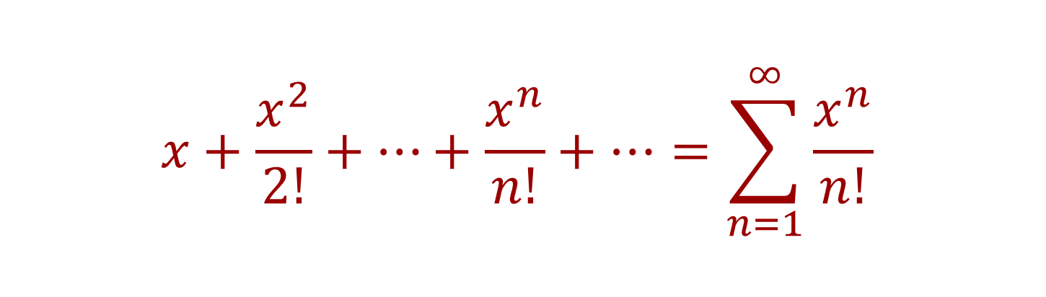
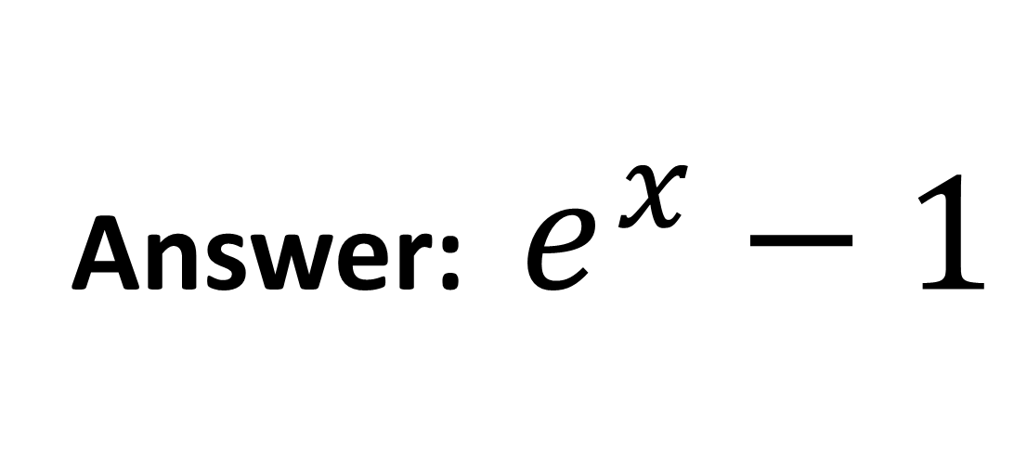
$$x+\frac{x^{2}}{2!}+…+\frac{x^{n}}{n!}+…=\sum_{n=1}^{∞}{\frac{x^{n}}{n!}}$$
Answer: $e^{x}−1$

Slide 34

$$1−\frac{x^{4}}{2!}+\frac{x^{8}}{4!}−…+{(−1)}^{n}\frac{x^{4n}}{\left(2n\right)!}+…=\sum_{n=0}^{∞}{{(−1)}^{n}\frac{x^{4n}}{\left(2n\right)!}}$$

Slide 35
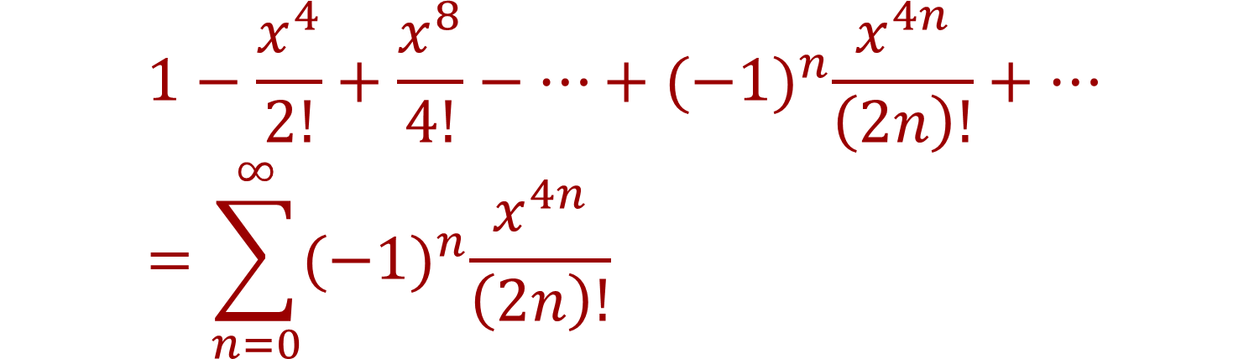
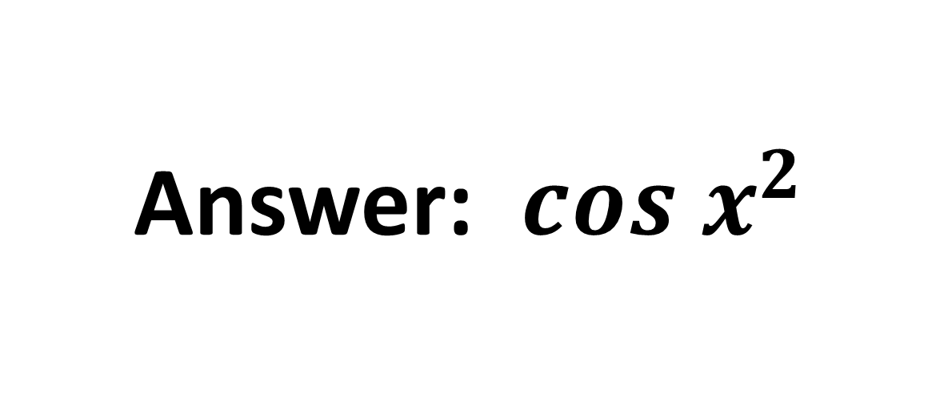
$$1−\frac{x^{4}}{2!}+\frac{x^{8}}{4!}−…+{(−1)}^{n}\frac{x^{4n}}{\left(2n\right)!}+…=\sum_{n=0}^{∞}{{(−1)}^{n}\frac{x^{4n}}{\left(2n\right)!}}$$
Answer: $cos x^{2}$

Slide 36

$$2x−\frac{{(2x)}^{2}}{2}+\frac{{(2x)}^{3}}{3}−…+{(−1)}^{n−1}\frac{{(2x)}^{n}}{n}+…=\sum_{n=1}^{∞}{{(−1)}^{n−1}\frac{{(2x)}^{n}}{n}}$$

Slide 37
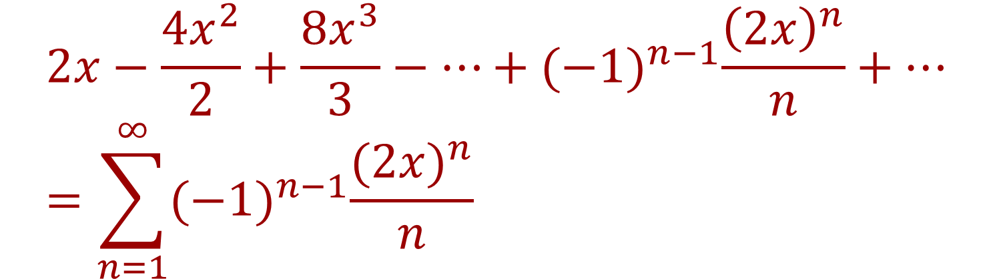
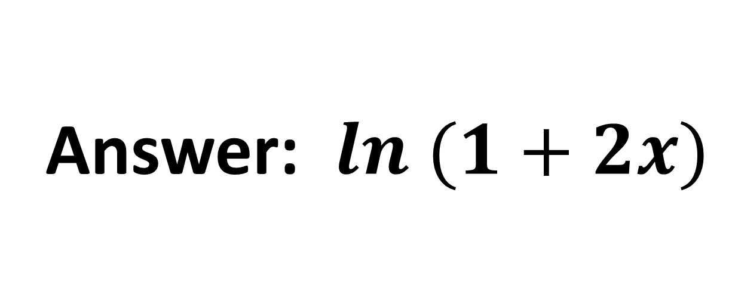
$$2x−\frac{{4x}^{2}}{2}+\frac{{8x}^{3}}{3}−…+{(−1)}^{n−1}\frac{{\left(2x\right)}^{n}}{n}+…=\sum_{n=1}^{∞}{{(−1)}^{n−1}\frac{{(2x)}^{n}}{n}}$$
Answer: $ln (1+2x)$

Slide 38

http://www.youtube.com/watch?v=xXbF-WaTz2Q

Slide 39
Name that Series is finite

