Slide 1
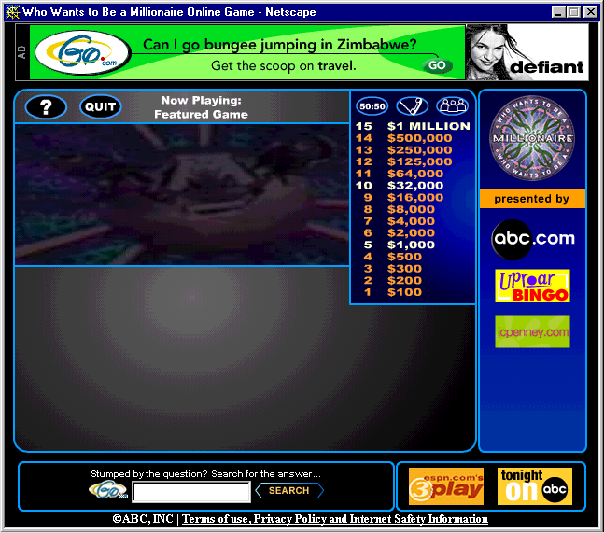
Who Wants to Be a Millionaire?

Slide 2
Anti- derivatives
_________________________
_____________________
_____________________
_____________________
___________________
___________________
__________________
_________________
_________________
_________________
_________________
______________
______________
______________
______________
Click the appropriate dollar amount at right to proceed to the question

Slide 3
Phone A Friend
“OK Contestant…Please select a friend to help you with this one. You have thirty seconds to discuss your options…”
Return to the Question

Slide 4
Ask the Audience
“Audience, we need your help on this one…in a moment, we’ll ask you to indicate, by show of hands, your choice for the correct answer…”
Return to the Question

Slide 5
Fifty - Fifty
50/50
You’ve asked that two of the wrong answers be eliminated, leaving you with one wrong answer plus the correct one.
Return to the Question

Slide 6
Correct
Correct!
Proceed to Next Question

Slide 7
Incorrect
Sorry, That’s Incorrect
Return to the Question

Slide 8





Question #1... $\frac{d}{dx}\int_{0}^{3x}{\cos\left(t\right)dt}$
50/50
$$−3 sin 3x$$
$$3 cos 3x$$
A
B
$$cos 3x$$
$$sin 3x$$
C
D

Slide 9





Question #2...
$$\int{(x^{2}+3x −5)dx=}$$
50/50
$$\frac{1}{3}x^{3}+\frac{3}{2}x^{2}−5x$$
$$\frac{1}{3}x^{3}+\frac{3}{2}x^{2}+C$$
A
B
$$2x+3+C$$
$$\frac{1}{3}x^{3}+\frac{3}{2}x^{2}−5x+C$$
C
D

Slide 10
Question #3... Using rectangles to estimate the area under a curve from x = a to x = b is
50/50
Trapezoid Sum
Triangle Sum
A
B
Riemann Sum
Some Sum
C
D

Slide 11





Question #4... The average value of
$f\left(x\right)=\sin{x}$ on the interval [0,π] is
50/50
$$\frac{2}{π}$$
$$\frac{1}{π}$$
A
B
$$2$$
$$1$$
C
D

Slide 12

Question #5... $\int_{2}^{e+1}{\left(\frac{4}{x−1}\right)dx=}$
50/50
4e
4
A
B
0
-4e
C
D

Slide 13

Question #6... Use the table below to find a right Riemann approximation with 4 subintervals for $\int_{3}^{12}{f\left(x\right)dx}$
x | 3 | 5 | 8 | 9 | 12
f (x) | 10 | 8 | 6 | 5 | 10
50/50
65
67
A
B
87.75
69
C
D

Slide 14





Question #7... $\int{x^{2}cos(x^{3})}dx$
50/50
$$−\frac{1}{3}sin \left(x^{3}\right)+C$$
$$\frac{1}{3}sin \left(x^{3}\right)+C$$
A
B
$$−\frac{x^{3}}{3}sin \left(x^{3}\right)+C$$
$$\frac{x^{3}}{3}sin \left(x^{3}\right)+C$$
C
D

Slide 15

Question #8... Trapezoidal sum overapproximates $\int_{a}^{b}{f\left(x\right)dx}$ and left Riemann sum underapproximates $\int_{a}^{b}{f\left(x\right)dx}$. Which of the following describes $f(x)$?
50/50
f(x) is inc and concave down
f(x) is inc and concave up
A
B
f(x) is dec and concave down
f(x) is dec and concave up
C
D

Slide 16





Question #9... $\int{sin \left(2x\right)dx}=$
50/50
$$−cos\left(2x\right)+C$$
$$cos\left(2x\right)+C$$
A
B
$$\frac{1}{2}cos\left(2x\right)+C$$
$$−\frac{1}{2}cos\left(2x\right)+C$$
C
D

Slide 17



Question #10...
If $f\left(x\right)=\int_{0}^{x+1}{\sqrt[3]{t^{2}−1}}dt$, then $f^{′}\left(2\right)=$
50/50
2
0
A
B
$$\sqrt[3]{15}$$
$$\sqrt[3]{−9}$$
C
D

Slide 18





Question #11... $\int{{\left(3x+1\right)}^{5}dx=}$
50/50
$$\frac{{\left(3x+1\right)}^{6}}{18}+C$$
$$\frac{{\left(3x+1\right)}^{6}}{6}+C$$
A
B
$$\frac{{\left(3x+1\right)}^{6}}{2}+C$$
$${\left(\frac{3x^{2}}{2}+x\right)}^{6}+C$$
C
D

Slide 19





Question #12... $\int{\frac{2x+3}{x^{2}+3x}dx=}$
50/50
$$\frac{1}{2}ln\left|2x+3\right|+C$$
$$ln\left|2x+3\right|+C$$
A
B
$$\frac{1}{2}ln\left|x^{2}+3x\right|+C$$
$$ln\left|x^{2}+3x\right|+C$$
C
D

Slide 20





Question #13... $\int{xe^{x^{2}}dx=}$
50/50
$$\frac{1}{2}e^{x^{2}}+C$$
$$2e^{x^{2}}+C$$
A
B
$$e^{x^{2}}+C$$
$$\frac{1}{2}x^{2}e^{x^{2}}+C$$
C
D

Slide 21

Question #14... The velocity, in ft/sec, of a particle moving along the x-axis is given by the function $v\left(t\right)=e^{t}+te^{t}$. What is the average velocity of the particle from time t = 0 to time t = 3?
50/50
60.257 ft/sec
20.086 ft/sec
A
B
40.671 ft/sec
79.342 ft/sec
C
D

Slide 22





Question #15... $g\left(x\right)=\int_{0}^{x}{\sin\left(t^{2}\right)dt}$ for $−1≤t≤3$. On which of the following intervals is g decreasing?
50/50
$$1.772≤x≤2.507$$
$$2.802≤x≤3$$
A
B
$$0≤x≤1.772$$
$$−1≤x≤0$$
C
D

